Slide 1
Semi-Supervised Learning
Dr. E. Sivasankar

Slide 2
Semi-Supervised Learning
Semi-supervised learning falls between unsupervised learning (without any labeled training data) and supervised learning (with completely labeled training data).
Semi-supervised learning is a class of machine learning tasks and techniques that also make use of unlabeled data for training – typically a small amount of labeled data with a large amount of unlabeled data.
Many machine-learning researchers have found that unlabeled data, when used in conjunction with a small amount of labeled data, can produce considerable improvement in learning accuracy over unsupervised learning, but without the time and costs needed for supervised learning.

Slide 3
Semi-Supervised Learning
The acquisition of labeled data for a learning problem often requires a skilled human agent (e.g. to transcribe an audio segment) or a physical experiment.
The cost associated with the labeling process thus may render a fully labeled training set infeasible, whereas acquisition of unlabeled data is relatively inexpensive. In such situations, semi-supervised learning can be of great practical value.
Semi-supervised learning is also of theoretical interest in machine learning and as a model for human learning.

Slide 4
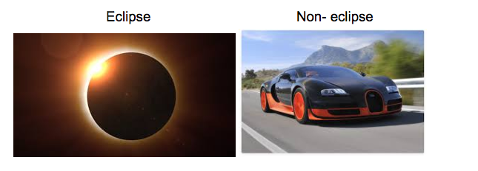
Semi-Supervised Learning for Image Classification Problem
Let’s say, we have a simple image classification problem. So, our training data consists of two labelled images as shown below.
So, we need to classify images of eclipse from the non-eclipse images. But, the problem is that we need to build our model on just a training set of just two images.

Slide 5
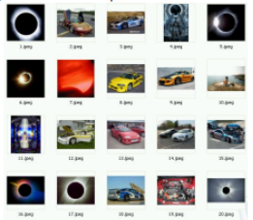
Semi-Supervised Learning for Image Classification Problem
Therefore, in order to apply any supervised learning algorithm we need more data to build a robust model.
To solve this purpose, we find a simple solution that we download some images from the web to increase our training data.
.

Slide 6
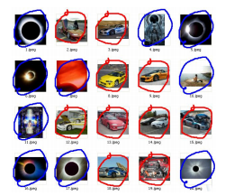
Semi-Supervised Learning for Image Classification Problem
But, for the supervised approach we also need labels for these images. So, we manually classify each image into a category as shown below.
.

Slide 7
Semi-Supervised Learning for Image Classification Problem
After running supervised algorithm on this data, our model will definitely
out-perform the model just containing two images in the training data.
But this approach is only valid for small purposes because human annotation to a large dataset can be very hard and expensive.
So, to solve these type of problems, we define a different type of learning known as semi-supervised learning, which is used both labelled data (supervised learning) and unlabelled data (unsupervised learning).
.

Slide 8
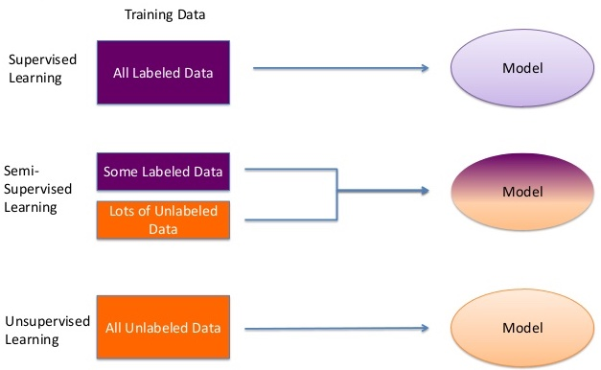
Semi-Supervised Learning

Slide 9
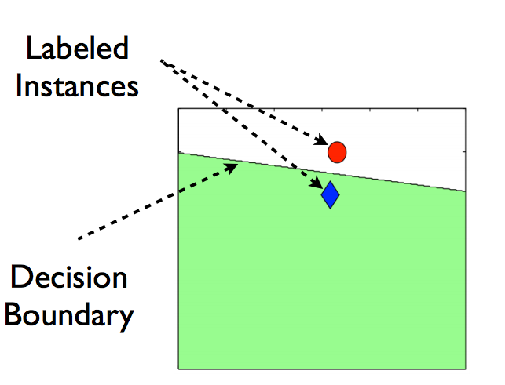
How Unlabelled data can help?
Consider a situation as shown below.
You have only two data points belonging to two different categories, and the line drawn is the decision boundary of any supervised model.

Slide 10
How Unlabelled data can help?
Consider a situation as shown below.
You have only two data points belonging to two different categories, and the line drawn is the decision boundary of any supervised model.

Slide 11
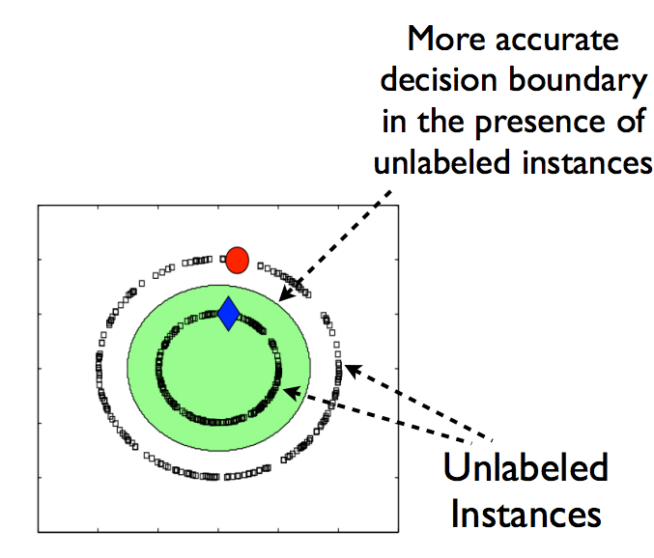
How Unlabelled data can help?
Now, let’s say we add some unlabelled data to this data as shown in the image below.
If we notice the difference between the above two images, you can say that after adding unlabelled data, the decision boundary of our model has become more accurate.

Slide 12
How Unlabelled data can help?
So, the advantage of using unlabelled data are:
Labelled data is expensive and difficult to get while unlabelled is abundant and cheap.
It improves the model robustness by more precise decision boundary.
Now, we have a basic understanding that what is semi-supervised learning

Slide 13
Introduction Pseudo Labeling
In this technique, instead of manually labeling the unlabelled data, we give approximate labels on the basis of the labelled data.
Let’s make it simpler by breaking into steps as shown in the image below.

Slide 14
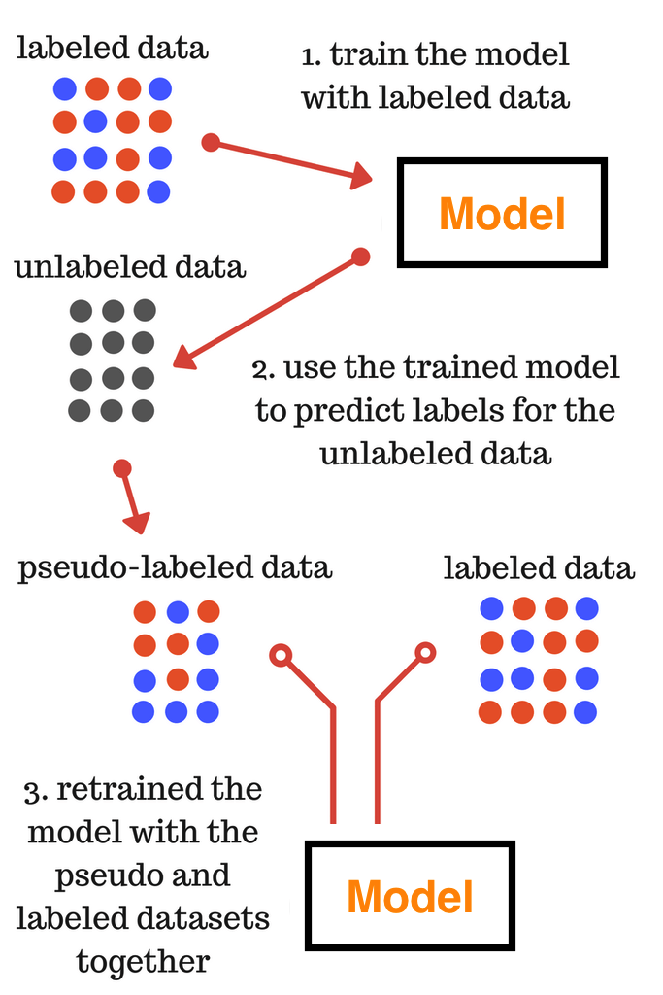
Introduction Pseudo Labeling

Slide 15
Self Training
Trains a model m on a labelled training set L and an unlabeled data set U.
At each iteration, the model provides predictions m(x) in the form of a probability distribution over the C classes for all unlabeled examples x in U.
If the probability assigned to the most likely class is higher than a predetermined threshold τ, x is added to the labeled examples with
p(x)=arg max m(x) as pseudo-label.

Slide 16
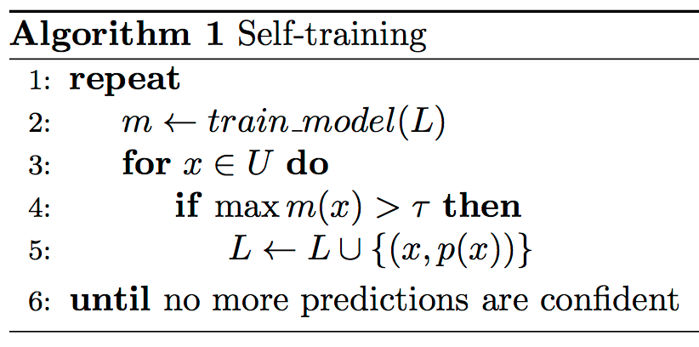
Algorithm

Slide 17
Self Training Example – Image Categorization

Slide 18
Self Training Example – Image Categorization

Slide 19
Contd.
EM algorithm
provides a general approach to learning in presence of unobserved variables.
In many practical learning settings, only a subset of relevant features or variables might be observable.
Eg: Hidden Markov, Bayesian Belief Networks

Slide 20
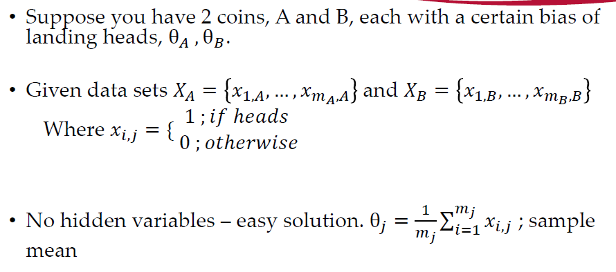
Contd.
Simple Example: Coin Flipping

Slide 21
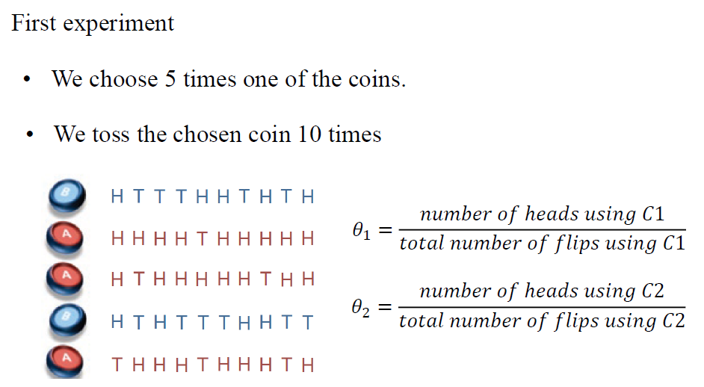
Contd.

Slide 22
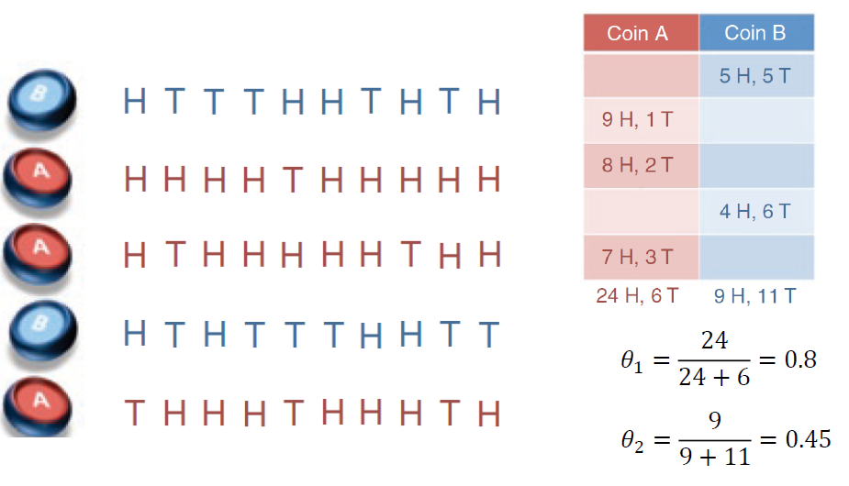
Contd.

Slide 23
Contd.
Coin A yields heads 80% of the time, coin B 45% of the time.
Questions?
What if we are given only the results of our coin tosses?
Can we guess the percentage of heads that each coin yields?
Can we guess which coin was picked for each set of 10 coin tosses?

Slide 24
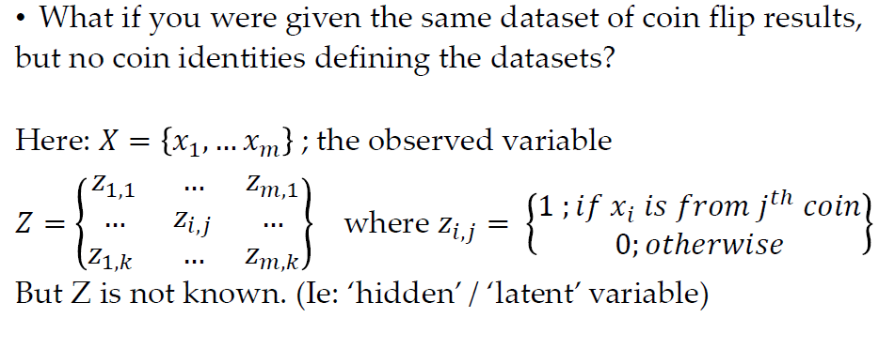
Coin Flip with Hidden variables

Slide 25
Contd.
Goal: determine coin parameters without knowing the identity of each data set’s coin.
Solution: Expectation-maximization

Slide 26
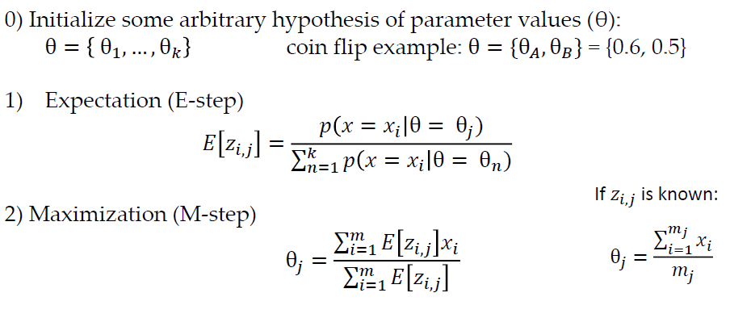
EM-Algorithm

Slide 27
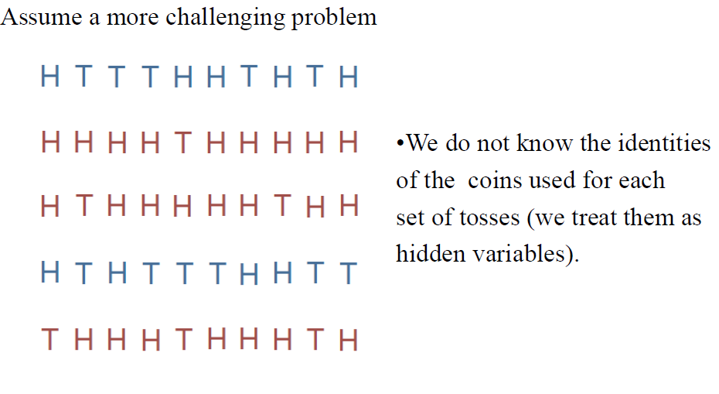
Example

Slide 28
Initial Step
Initialize θA and θB to chosen value
Ex: θA=0.6, θB= 0.5
Compute a probability distribution of possible completions of the data using current parameters

Slide 29
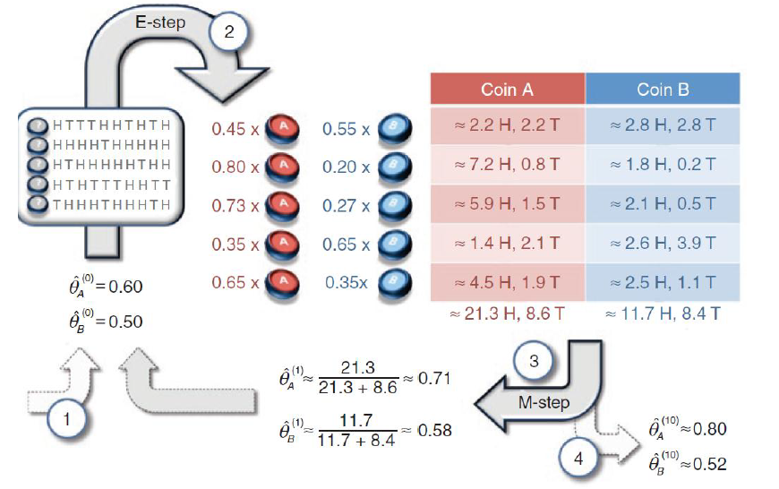
E-Step & M-Step

Slide 30
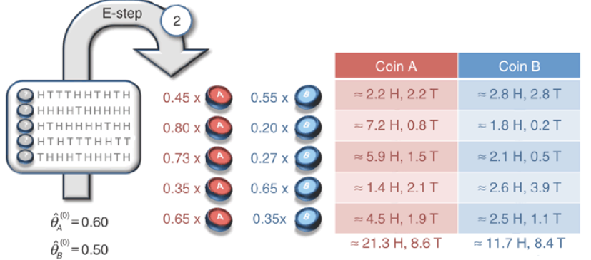
E-Step Estimating liklihood each coin was chosen

Slide 31
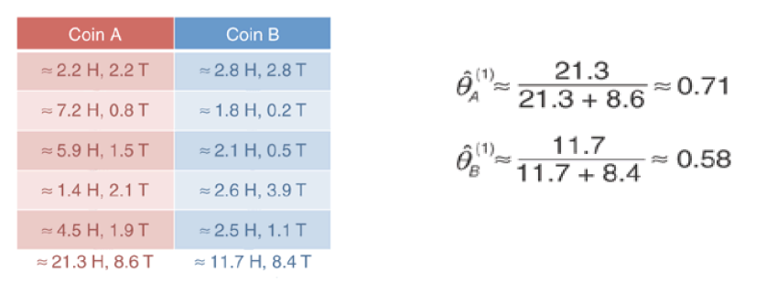
M-Step

Slide 32
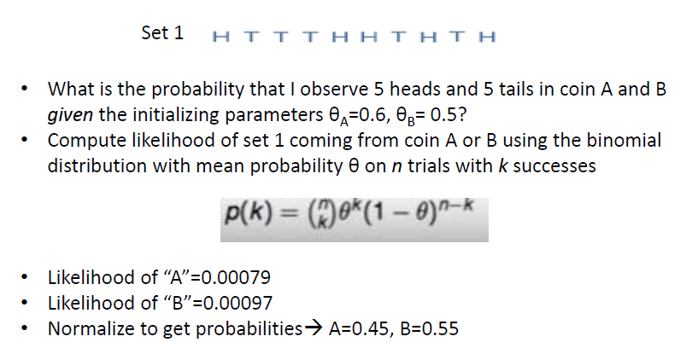
Cont.

Slide 33
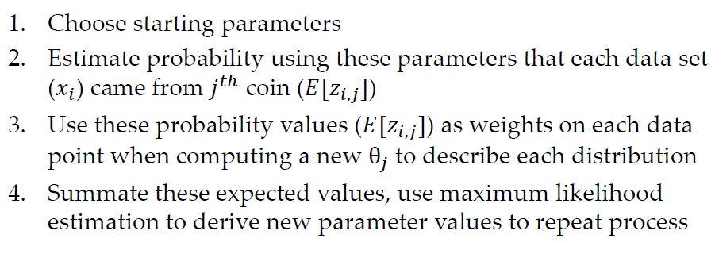
Summary

Slide 34
Domain Adaptation
 | Electronics | Video games
+ | Compact; easy to operate; very goodpicture quality; looks sharp! | A very good game! It is action packed and full of excitement. I am very much hooked on this game.
+ | I purchased this unit from Circuit City and I was very excitedabout the quality of the picture. It is really niceand sharp. | Very realistic shooting action and goodplots. We played this and were hooked.
- | It is also quite blurry in very dark settings. I will never buy HP again. | The game is so boring. I am extremely unhappy and will probably never buy UbiSoft again.
Pivot Words: good, excite, nice, never buy
Non- Pivot Words:Compact, sharp, blurry, hooked, realistic, boring

Slide 35


Point-wise Mutual Information(PMI)
Estimate the orientation of each extracted phrase using the PMI measure.
PMI is the amount of information that we acquire about the presence of one of the words when we observe the other.
The opinion orientation (OO) of a phrase is computed based on its association with the positive reference word “excellent” and its association with the negative reference word “poor”.
Here excellent is replaced by some frequent positive word and poor is replaced by some frequent negative word

Slide 36
PMI measures the mutual dependence of between two instances or realizations of random variables.
Positive => high correlated
Zeros => no information (independence)
Negative => opposite correlated

